Slide 1
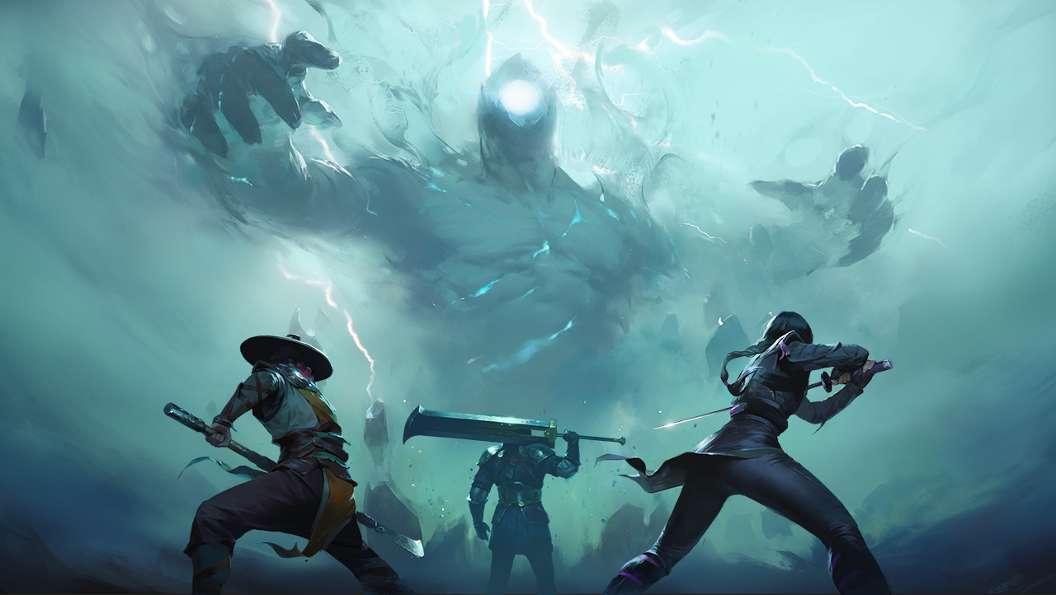
Stick Fighter
Introduction to Computer Science: Final Project
A TWO PLAYER FIGHTING GAME
Hailemariam Mersha and Ahmmed Razee
4/25/2024

Slide 2
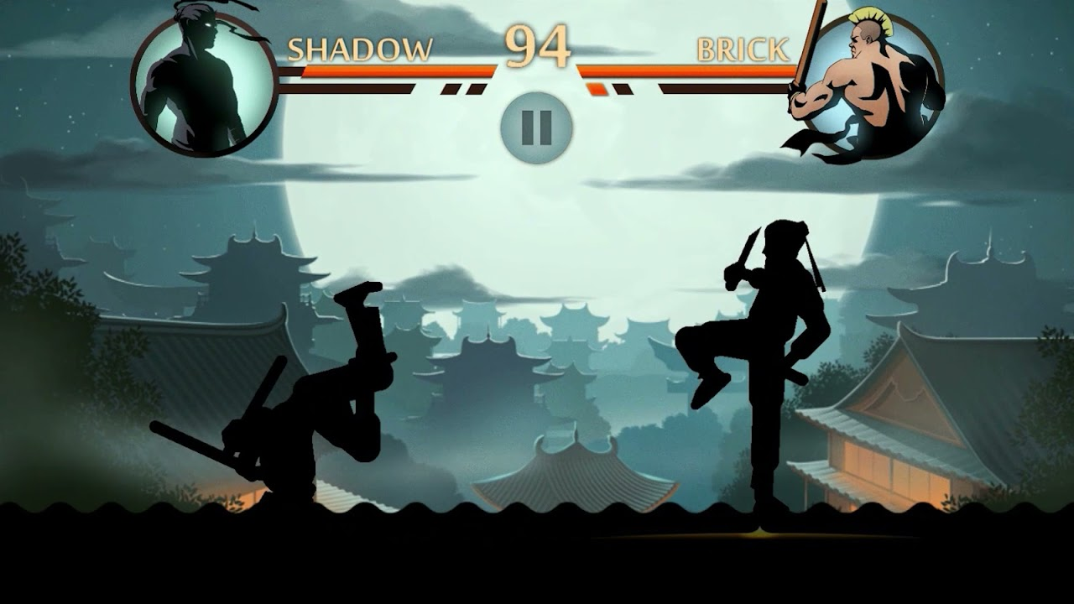
INSPIRATION
Inspired by a mobile game named Shadow fight
A 2D fighting game
Known for intense combat mechanics and engaging gameplay
Notes:
Ahmmed

Slide 3
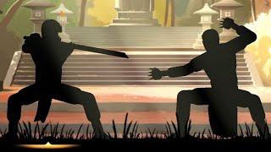
SHADOW FIGHT 2
Notes:
Ahmmed

Slide 4

IMPLEMENTATION
A simpler version of Shadow fight 2 experience
Using another game’s concept for graphics - Stickman Fighter
Two characters positioned facing each other, ready for combat at the beginning
Notes:
Haile

Slide 5
GAME PLAY
Players can kick, punch or block using the keyboard keys.
When a player takes damage, his health bar decreases until he dies and the game is over.
No two attacks can simultaneously be delivered. If being attacked, your option is to jump, block or run.
Notes:
Haile

Slide 6
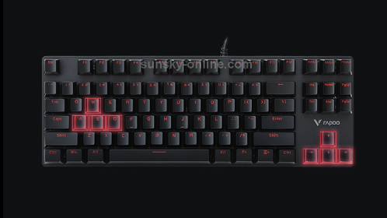
CHARACTER CONTROLS
Player 1
Player 2
Notes:
Ahmmed

Slide 7
COMBAT MECHANICS
Punch: Inflicts 5 points of damage on the opponent's health bar.
Kick: Inflicts 10 points of damage on the opponent's health bar.
Blocking: Reduces incoming damage by half when the down key is pressed.
Jumping: Allows characters to avoid attacks and create distance from their opponent.

Slide 8
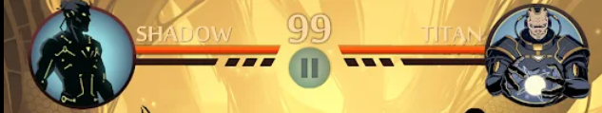
HEALTH BAR
Each character has a health bar displayed at the upper left and right corners, indicating their current health status.
The game ends when one fighter's health bar reaches zero, declaring the other as the winner.
Players have the option to restart the game after a winner is declared.

Slide 9
TASK DIVISION
Graphics and Environment: Hailemariam
Code/Object-Oriented Programming: Both
Music and Sound: Ahmmed
Gameplay: Hailemariam
Display: Ahmmed
Notes:
4,5,8

Slide 10
Questions or Suggestions?
THANK YOU

